Slide 1



Slide 2

Lecture class (20%) (Term 1)
GET (40%) (End of Term 1)
Online English Study (20%，exempt. 90 points)
Listening and speaking by foreign teacher (20%，Term 2)

Slide 3

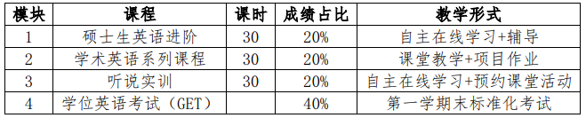

Slide 4
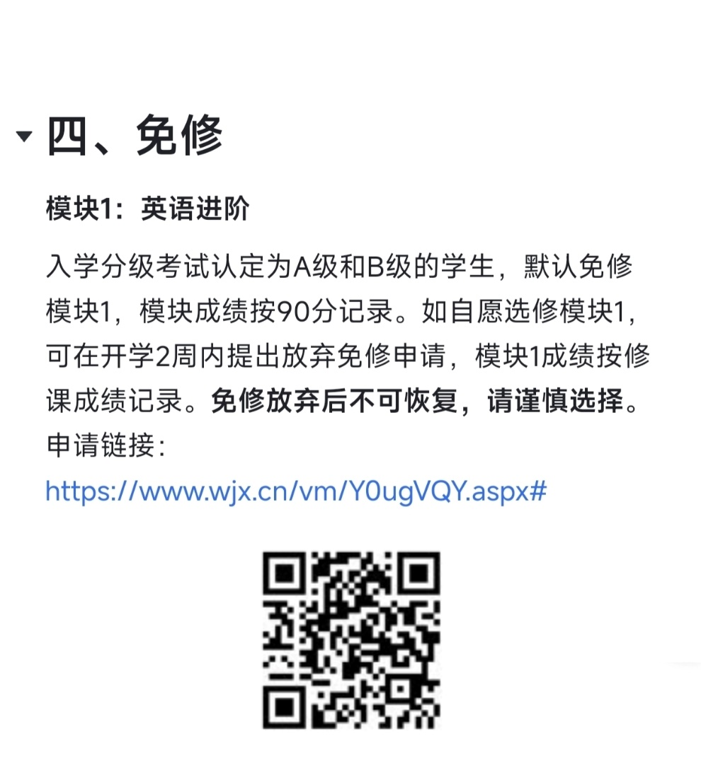
Apply for M 1

Slide 5
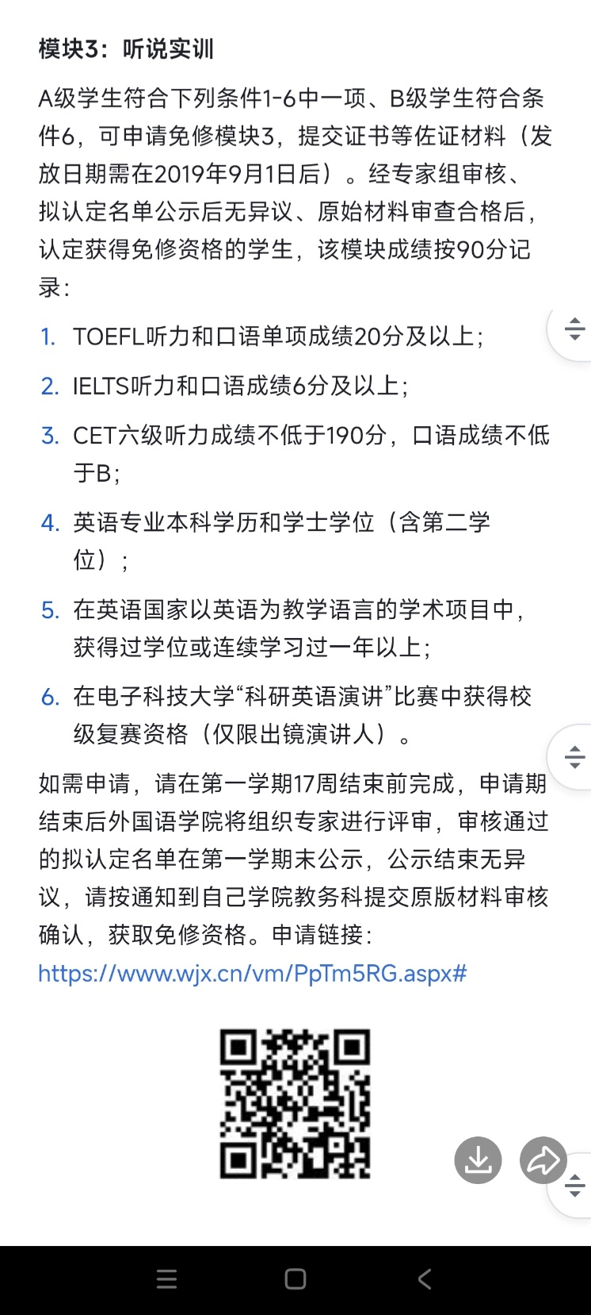
Apply for exemption of M3

Slide 6


外国语学院 教务科61831622
研究生教学邮箱
研究生学位英语实施方案：
https://i.study.uestc.edu.cn/ems/menu/home
https://uestc.feishu.cn/docx/JmhldtIzoo7Dp7xPbU9cYO3BnBM

Slide 7
魏全凤: QQ 358993048（立人楼A207）
QQ group:
B17:Tues.34: 664673915.
B18:Tues.78: 663447307.
B19:Wed. 34: 285793596.
B20:Wed.78: 740333556.

Slide 8

Target: 20%;
Class Performance:
class participation, attendance, presentation, homework, quiz

Slide 9

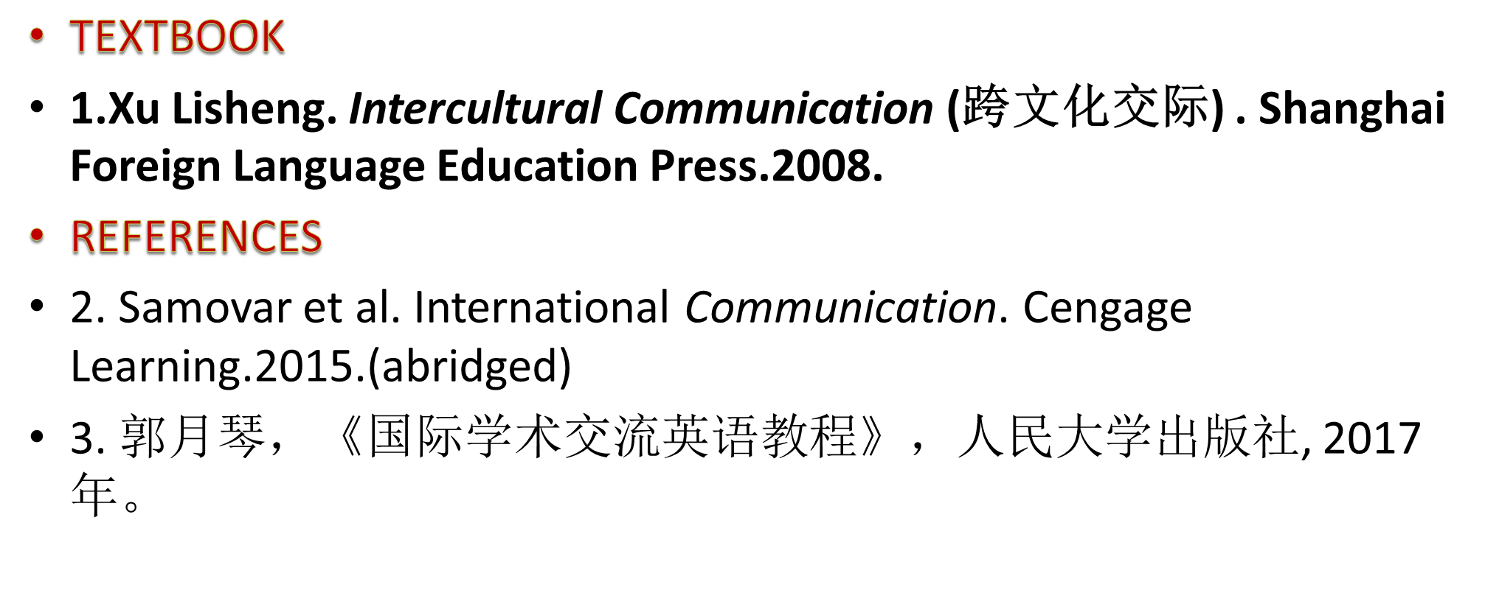

Slide 10

Textbook:Book1

Slide 11


Reference:Book2
Reference:Book3

Slide 12

1. Introduction to communication and Culture
2. Principles of communication
3. Verbal communication(language and its use)
4. Nonverbal communication
5. Cultural patterns
6. Theories in intercultural communication
7. Ethics in cross-cultural communication
8. Cultural diversity
9. Cultural root and prospect
…

Slide 13

Lecturing 40 min
Presentation 30 min
Practice 20 min (exercise, discussion, etc)
After-class exercise (flexible)

Slide 15
Presentation
1. to present one by one.(One week, one group of 5 members. )
2. It will be marked in class.(5 min. manner, logic, familiarity with the text)
3. Interaction and communication.(It can attract the audience.)

Slide 16

No cheating. Be honest.
Correction on time.
Be your best.
No absence.
English competence.

Slide 17
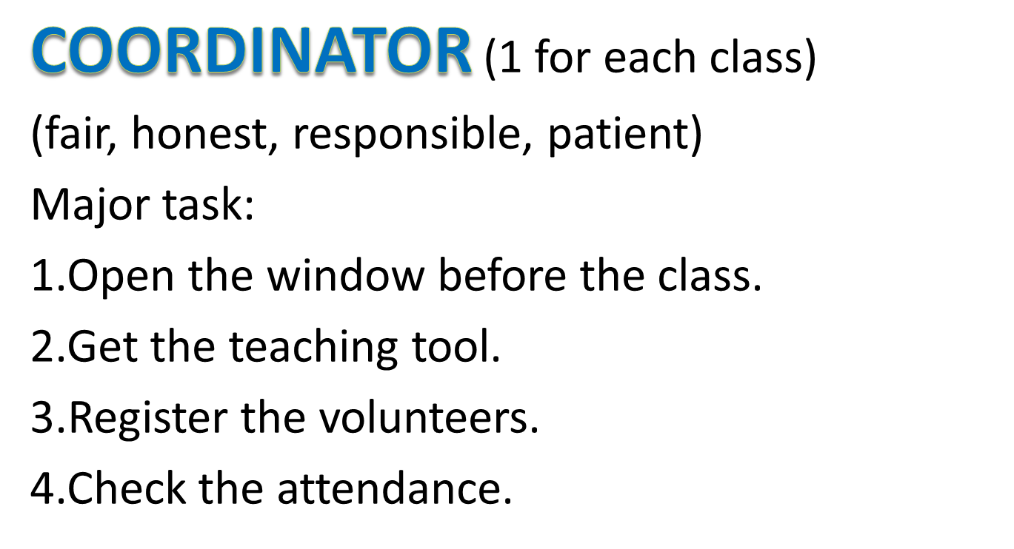

Slide 18
Absence: -2
Cheating:-5
Being late:-0.5
Ask-for-leave: .(Please tell volunteer or teacher BEFORE the class; if more than 3 times, see absence.)
Answering as required: -1, 0, 1
Voluntary answering: +1 (at most 3 times in each class)
Exercise:( 0~3)
Quiz:+(0~10)
presentation(0-10)
The total points will decide your final score.(participation, exercise, quiz, presentation)

Slide 19

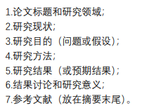
What is my recent research?

Slide 20
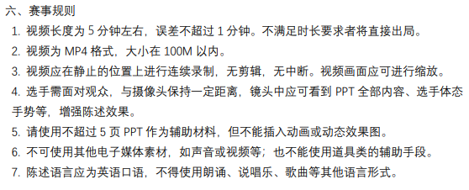

Slide 21
Bonus for participants in my class
2-3 points

Slide 22

You need to have a good rest if you feel ill!

Slide 23
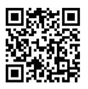
Task 1 Questionnaire

Slide 24


